Slide 1
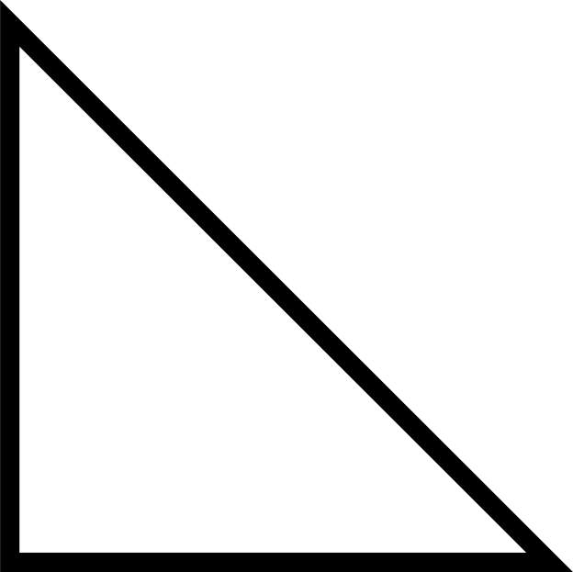
COP 4530 - DATA STRUCTURES
DIJKSTRA'S
ALGORITHM
BY KRISH VEERA AND JONATHAN KOCH

Slide 2

MECHANISM
01
DIJKSTRA VALUE INITIALIZED - TRACKS THE WEIGHTAGE THAT THE ALGORITHM ENCOUNTERED WHILE BEING EXECUTED.
02
DIJKSTRA VALUE FOR START NODE = 0 AND ALL THE OTHERS ARE MARKED ∞ SINCE NO NODES HAVE BEEN ENCOUNTERED YET.
HANDS-ON
03
AFTER PEEKING ALL THE EDGES CONNECTED TO THE NODE AND THEIR WEIGHT THE ALGORITHM THEN CHOOSES THE ONE WITH THE SMALLEST VALUE AND ADDS IT TO THE SHORTEST PATH.
04
THE NODE IS MARKED VISITED AND THE PROCESS IS REPEATED UNTIL THE DESTINATION HAS BEEN REACHED.

Slide 3

LIMITATION
THE DIJKSTRA’S ALGORITHM CAN ONLY WORK WITH POSITIVE WEIGHTS OF EDGES. THEREFORE, IT CAN ONLY BE IMPLEMENTED
on a non-negative weighted graph.

Slide 4

TIME COMPLEXITY
O(N+E*LOG(N))
N: Number of Nodes in the Weighted Graph
E: Number of Edges in the Weighted Graph

Slide 5
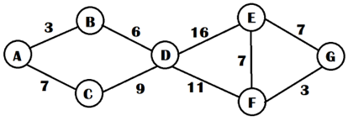
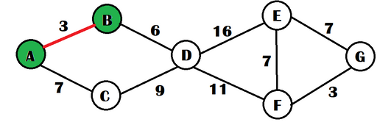
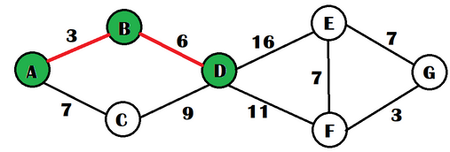
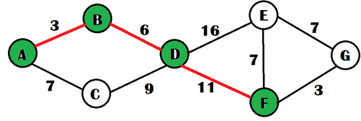
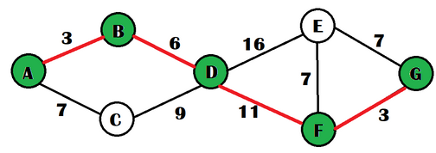
IMPLEMENTATION EXAMPLE

Slide 6
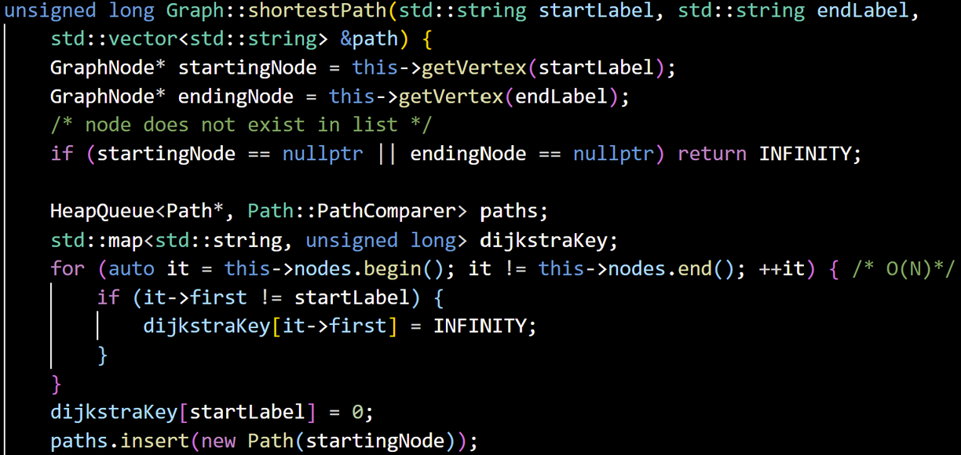
INITIALIZATION

Slide 7
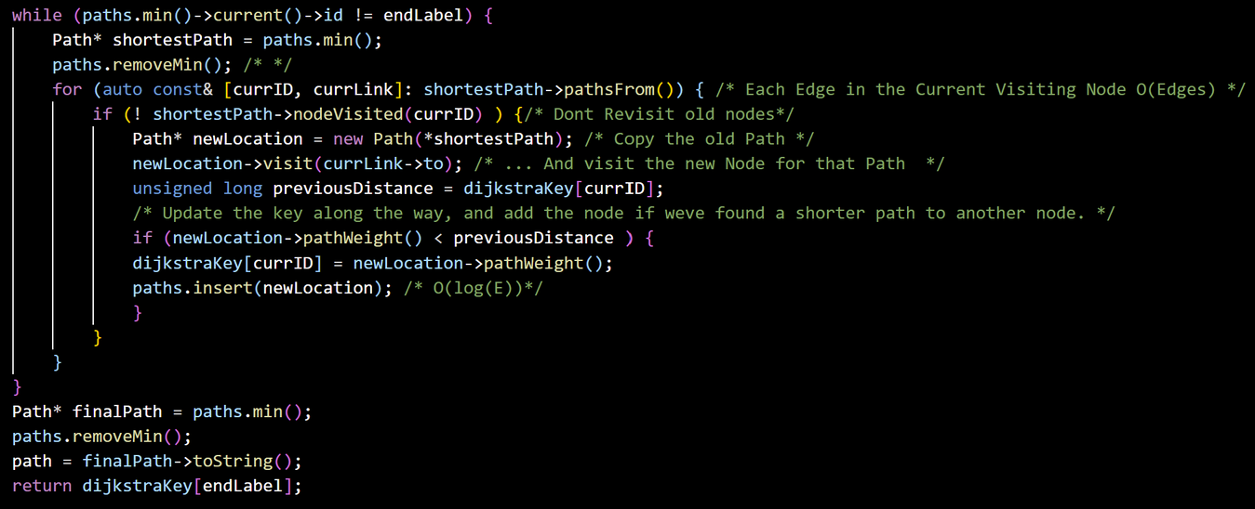
ALGORITHM IMPLEMENTATION

